Slide 1
Downloading Files from GitHub
https://github.com/The-Assembly/Snapchat-filter

Slide 2
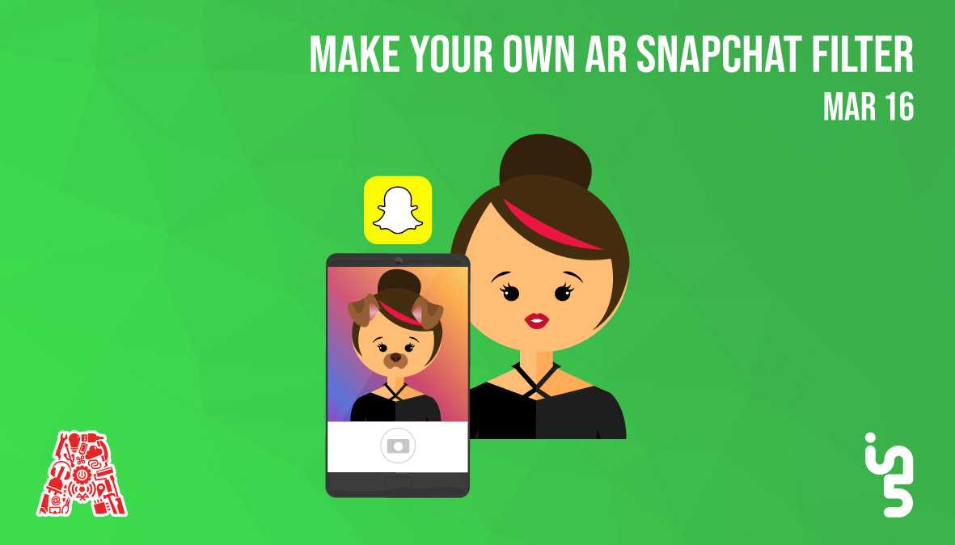

Slide 3
About the Assembly
A smart lab based out of In5 since Dec 2014
Over 200 free workshops done
ASSEMBLY: HACK - Embedded systems, iOT and hardware
ASSEMBLY: CODE - Software projects - APIs, frameworks, apps
Age range: 16-60 - students, professionals, entrepreneurs
Focus on smart technology and practical applications
Forum: members.theassembly.ae

Slide 4
TAG US ON OUR SOCIAL MEDIA
FACEBOOK
TWITTER
INSTAGRAM
YOUTUBE
The Assembly (@MakeSmartThings)
@MakeSmartThings
@MakeSmartThings
The Assembly

Slide 5
Agenda
Snapchat - Introduction
What is Lens Studio?
Layout of Lens Studio
Download resources from GitHub
Difference Between Face Sprite and Face Mask
Designing Face Lens
Send Lens to Your Device
Publish Lenses
Designing 3D Animated Object Filter
Designing Snapchat Games
Conclusion
Notes:
*add cheat sheet for all the commands etc

Slide 6
Introduction to Snapchat
Notes:
*add cheat sheet for all the commands etc

Slide 7
Lens Studio
Real-time tool for creating Snapchat Lenses.
Create Face Lenses (front camera experiences)
Create World Lenses (rear camera experiences).

Slide 8
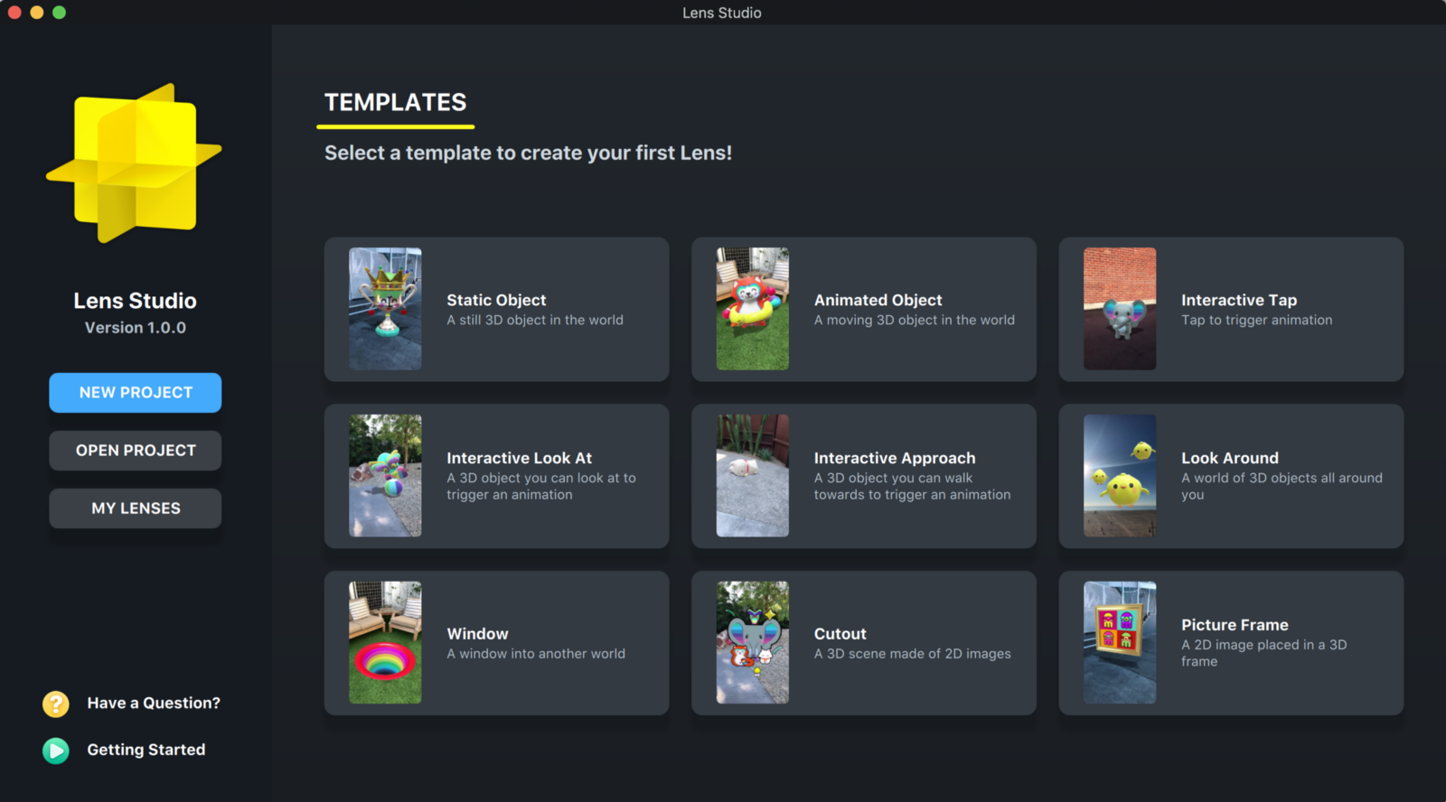

Slide 9
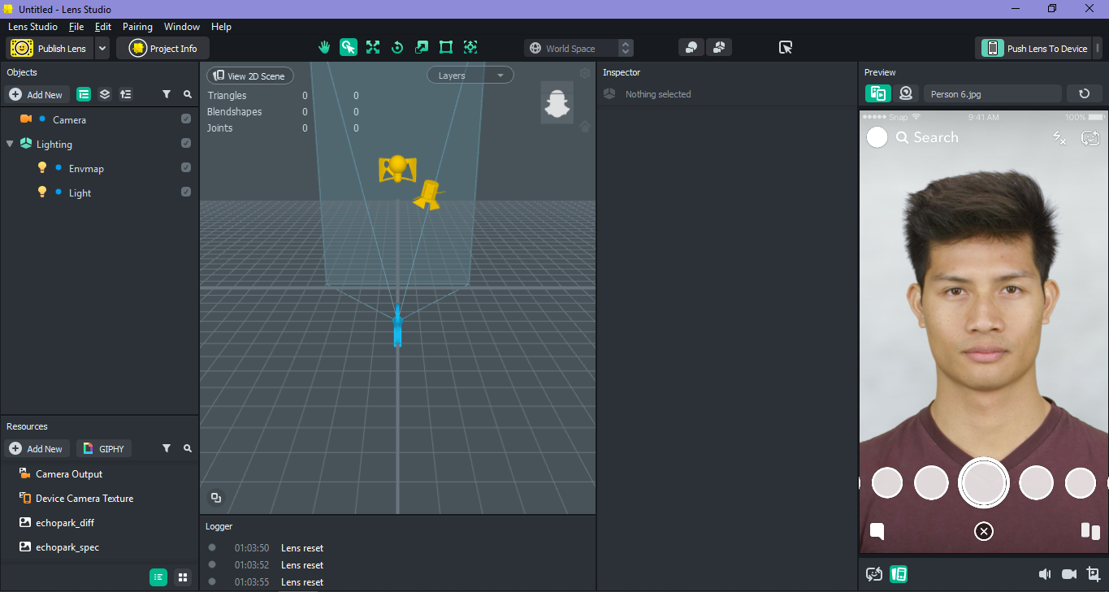
Menu Bar
Inspector Panel
Objects Panel
Preview Window
Resources Panel
Scene View
Logger Panel
Camera/sound/
video options

Slide 10
Downloading Files from GitHub
https://github.com/The-Assembly/Snapchat-filter

Slide 11
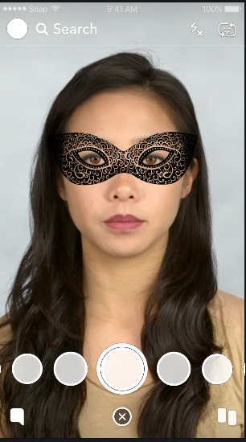
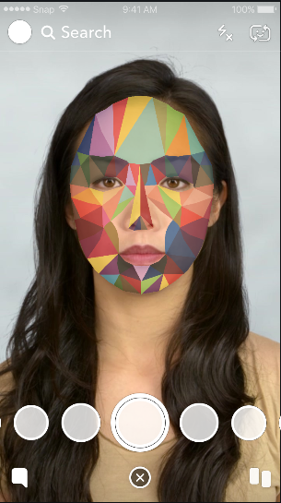
FACE SPRITE
FACE MASK

Slide 12
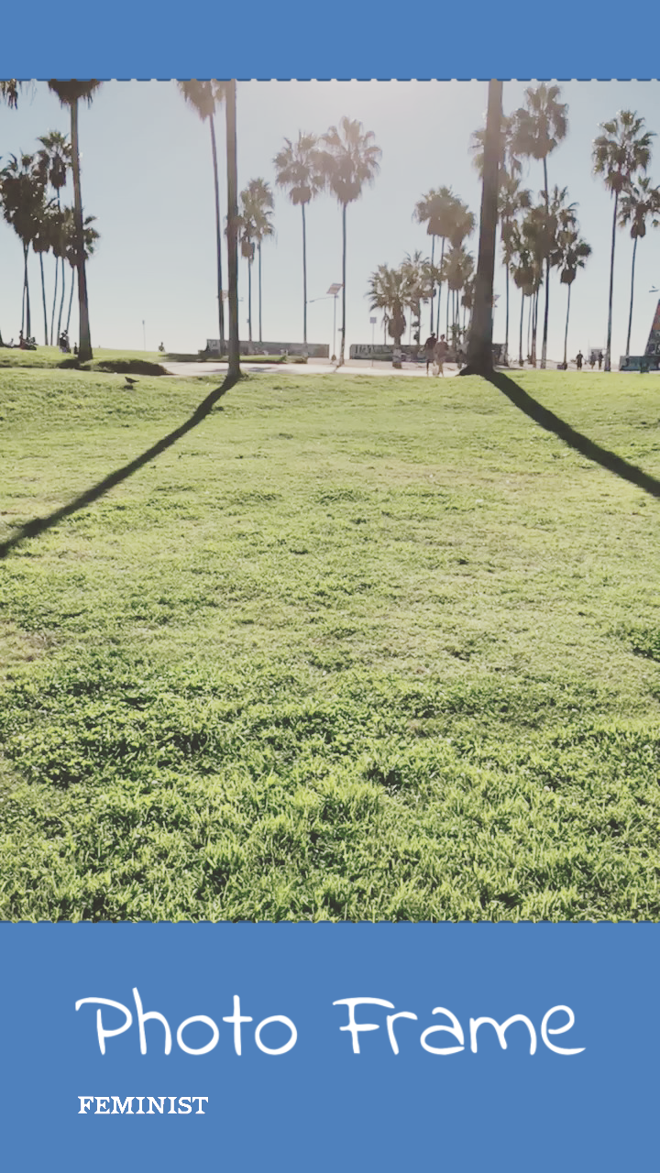
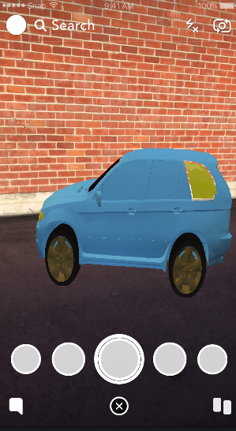

Slide 13
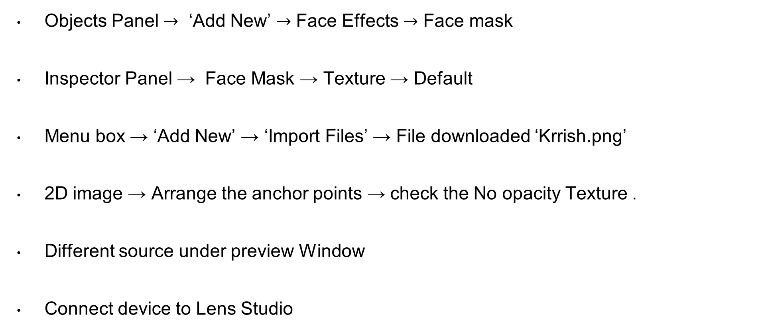
Designing Face Lens
Objects Panel $→$ ‘Add New’ $→$ Face Effects $→$ Face mask
Inspector Panel → Face Mask → Texture → Default
Menu box → ‘Add New’ → ‘Import Files’ → File downloaded ‘Krrish.png’
2D image → Arrange the anchor points → check the No opacity Texture .
Different source under preview Window
Connect device to Lens Studio

Slide 14
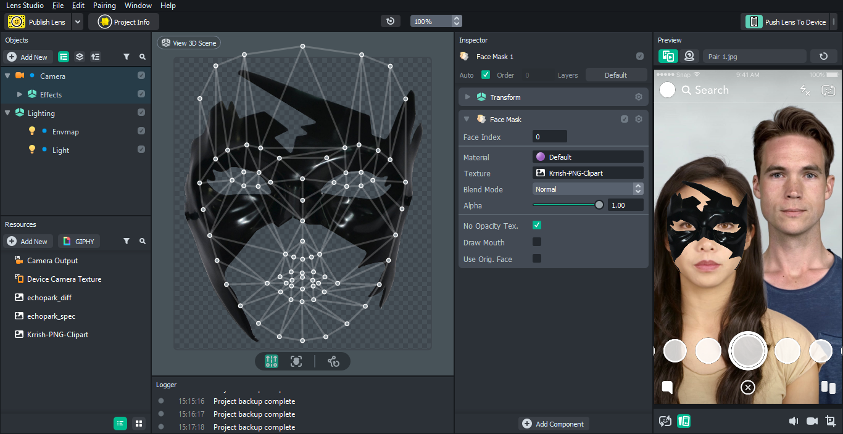

Slide 15
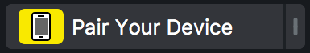
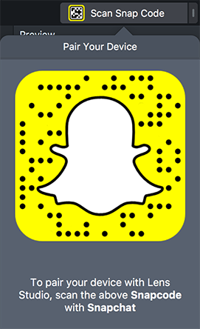
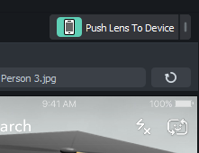
Send Lens to Your Device
Over the Preview Window click on ‘Pair Your Device’.
Scan the snap code with Snapchat.
Once paired, click on ‘Push Lens to Device’.

Slide 16
Publish Lenses
Click on Publish Lens in the Menu Bar.
Enter the necessary details.
Sign in to you Snapchat Account.
Upload the Lens!
NOTE: Will take a few days to get reviewed by Snapchat. Can check the status of your lens by clicking on My Lenses.
NOTE: Once published, your lens will last for 48 hours to use by the public.

Slide 17
Designing 3D Animated Object Filter
Animated Object template
File→ Import → Downloaded file
Objects Panel → WorldObjectController → Idle Animation Setting tab → Downloaded Animated file
Idle Anim Layer→ ‘Layer0’
Delete RED_PANDA_FBX

Slide 18
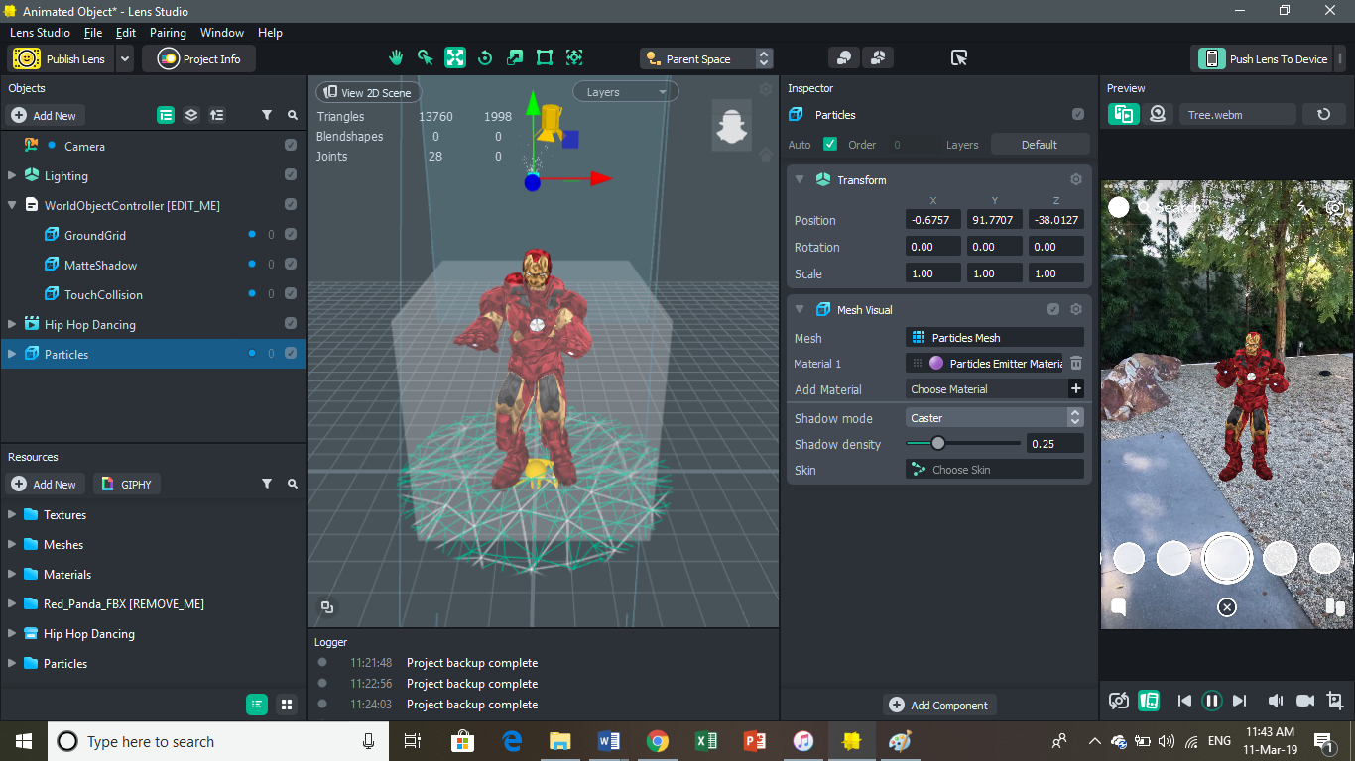

Slide 19
Designing 3D Animated Object Filter
Resize model size (42-45 in all axis)
Objects Panel → ‘Add New’ → “Particles” (resize to 4)
Edit the particles
Inspector Tab (imported animated file) → ‘Add Component’ → ‘Audio’
Import appropriate Audio Track → Tick Autoplay Loop
Send it to Mobile Device

Slide 20
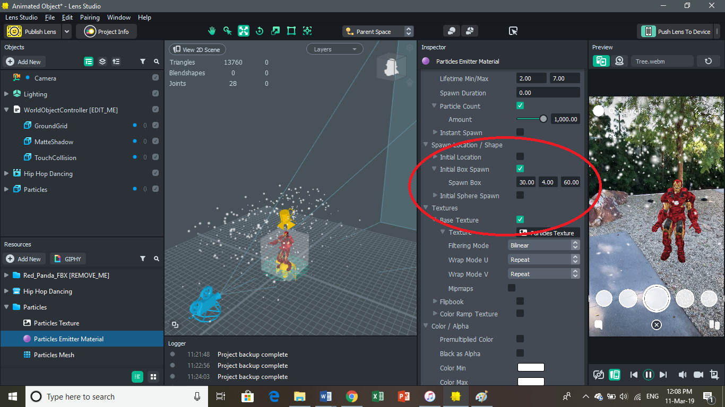

Slide 21
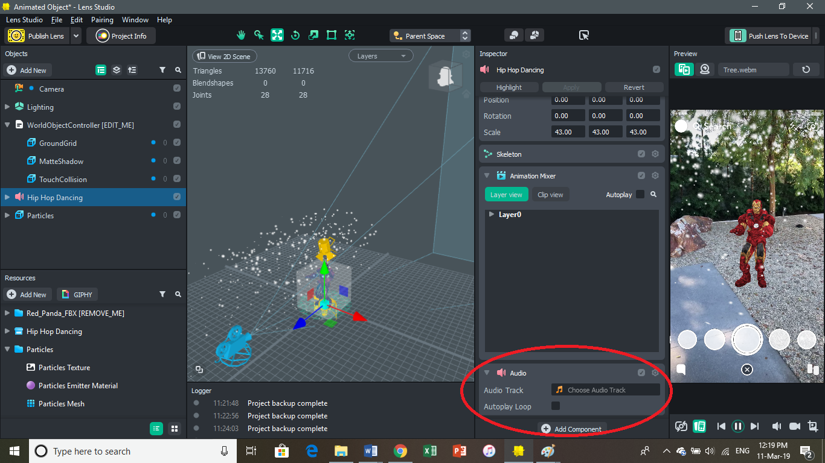

Slide 22
Designing a Game Lens
Import the files from GitHub under Resources.
Resources -> New folder -> Scripts
Resources -> New folder -> Assets.
Create sphere, ring and add the accurate scripts.
Create prefab so any changes to a scene object will apply to multiple objects of the same scene object.
Make the necessary changes.
Push lens to device.

Slide 23
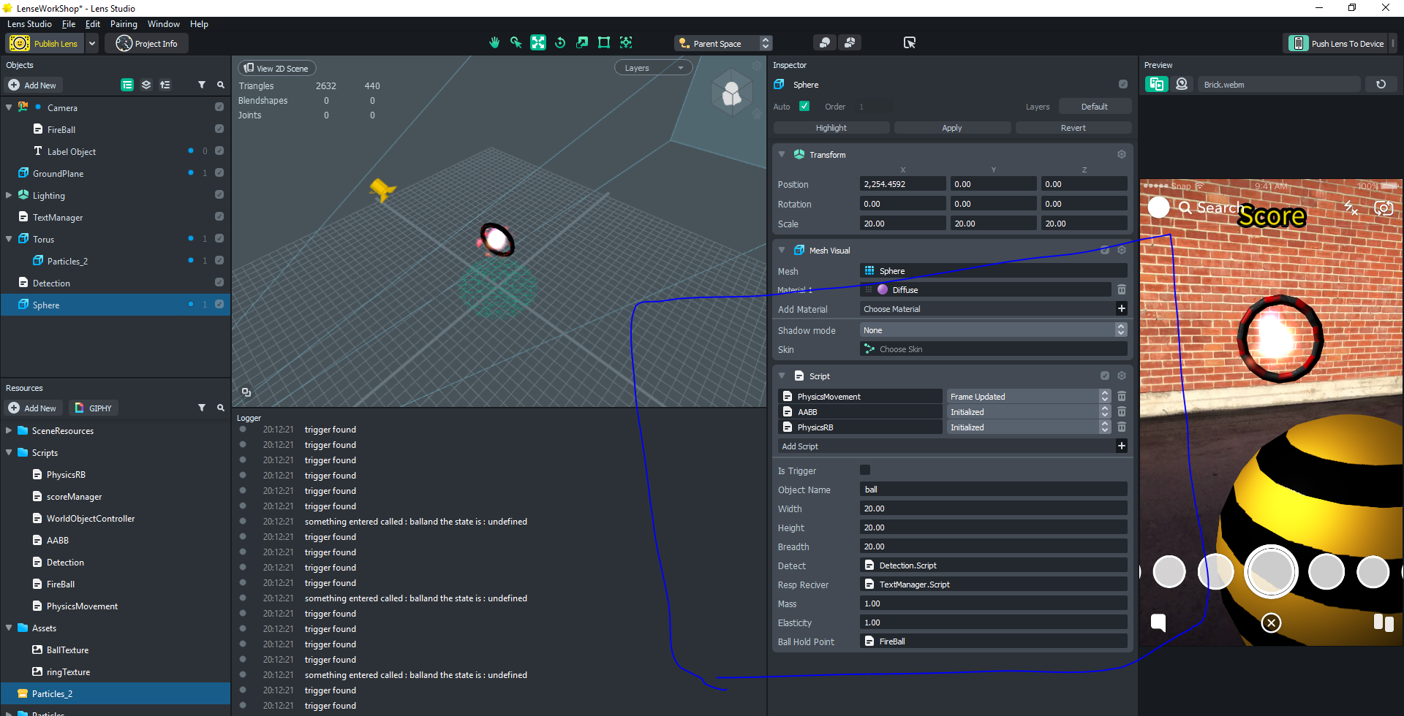

Slide 24
THANK YOU!

